Slide 1
Are Many-core Processors Useful for Weather and Climate Modeling?
Dr. Richard Loft
Director, Technology Development
Computational and Information Systems Laboratory
National Center for Atmospheric Research
SDSU CSRC Colloquium Series
March 29, 2013

Slide 2
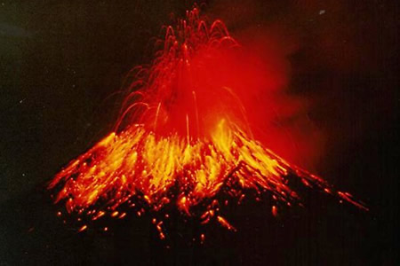
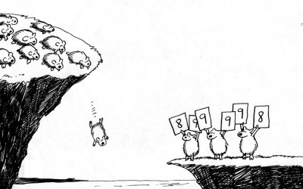
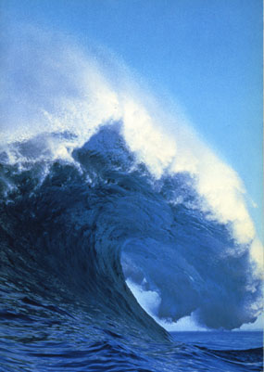
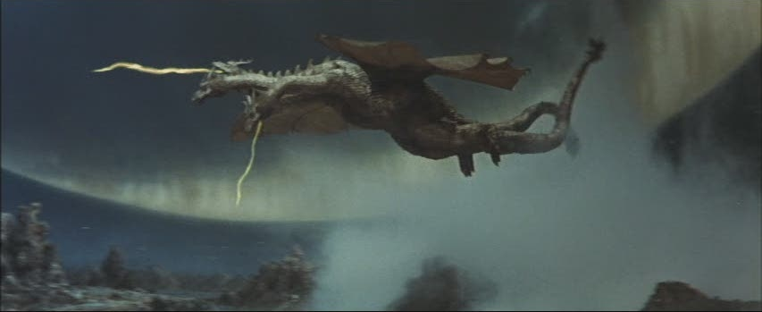
What do you think of when you think of many-core systems?

Slide 3
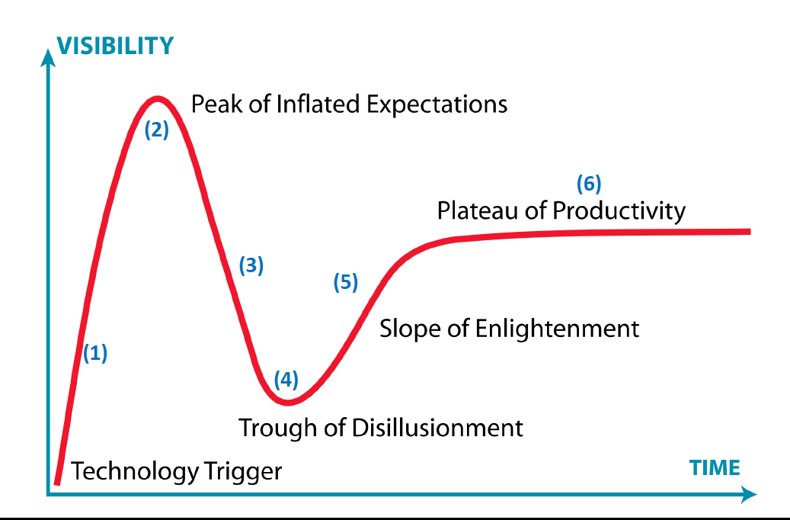
In short, where are you on the Gartner Hype cycle ?

Slide 4
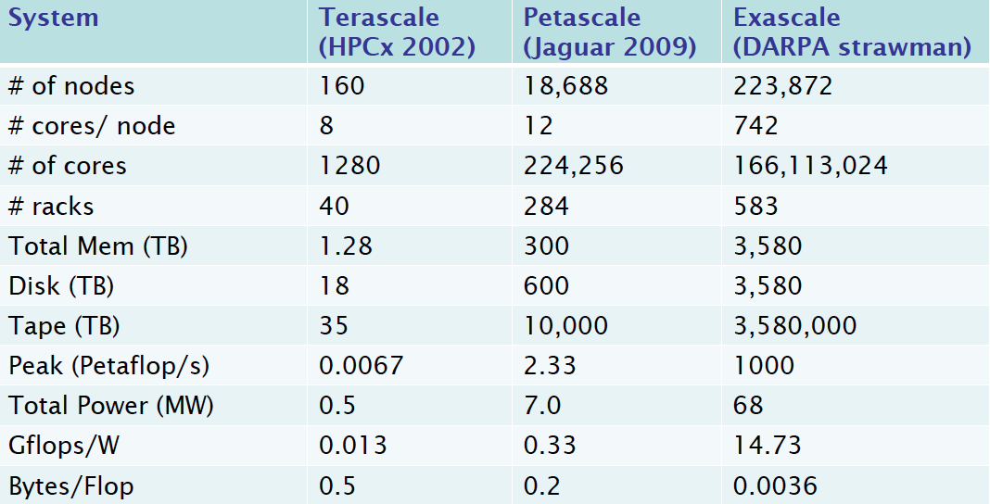
Projected Path to the Exascale (10¹⁸ flops)
Credit: Mike Ashworth, STFC, Daresbury, UK

Slide 5
Why are we turning to many-core?
Since 2005 processor clock speeds have stagnated
Why? Power consumption of high-GHz silicon
Many-core design emphasizes executing many concurrent threads slowly, rather than executing a single thread very quickly.
Where are we going? processors with hundreds of cores and thousands of threads

Slide 6
Why we’re turning to many-core: Energy to do a double precision FLOP
Blue Fire (649 KW/59.7 TFLOPS)
10,873 pJ/FLOP
Yellowstone (1.9 MW/1.5 PFLOPS)
1,490 pJ/FLOP (huge improvement!)
Many-core systems:
IBM Blue Gene/Q: 501 pJ/FLOP
NVIDIA KEPLER GPU: 200 pJ/FLOP (estimated)
Exascale target (DARPA): 68 pJ/FLOP = 68 MW system

Slide 7
Heterogeneous, many-core co-processor node architecture
to interconnect
NIC
….
DRAM
DRAM
Accelerator
Accelerator
One or More Multicore Sockets
PCIe Bus

Slide 8
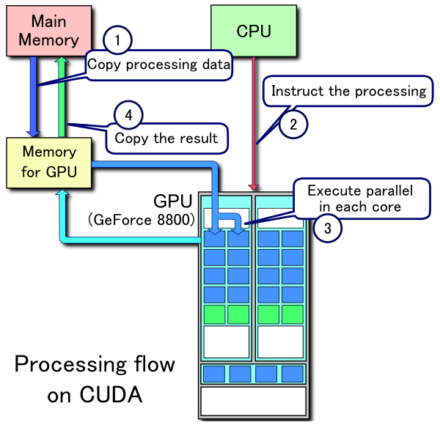
The PCIe straw: how CPU’s talk to GPU’s

Slide 9
Prototypes of next-gen architectures are here and they are disruptive
XSEDE: TACC Stampede (2013)
10 PF
Intel MIC +Intel Sandy Bridge
DoE: ORNL Titan (2012)
~20 PF
18K NVidia Kepler GPU’s + AMD Interlagos
NSF Track 1: NCSA Blue Waters (2012)
>11.5 PF
AMD Interlagos + 3000 NVidia Kepler GPU’s
DoE: Argonne Mira (2012)
9.2 PF
45,152 BG/Q System on a Chip (SoC)

Slide 10
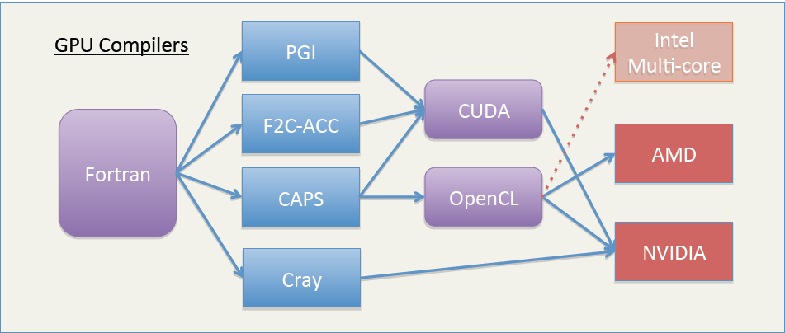
Current Pathways from Fortran to Many-core Hardware
Intel
Due to Mark Govett, NOAA

Slide 11
The Typical Trouble with Atmospheric Models and Accelerators
Due to Bill Putman, NASA

Slide 12
The right and wrong way to measure, report, and think about many-core performance
How many here remember
D.H. Bailey’s 1991 paper?

Slide 13
12 Ways to fool the masses with GPUs
Quietly rewrite the code in CUDA.
Quote only 32-bit performance results, not 64-bit results.
Ignore PCIe bus transfer times when reporting performance.
Present performance figures for an inner kernel, and then represent these figures as the performance of the entire application.
Scale up the problem size to supply the GPU with a massive number of threads, but omit any mention of this fact.
Quote performance results projected to a full system ignoring MPI overhead.
Compare your GPU results to a single core of an older Xeon.

Slide 14
12 Ways to fool the masses with GPUs
8. Quote performance in terms of peak flops, flops/$, or flops/watt, anything but time to solution.
9. Mutilate the algorithm used in the GPU implementation to match the architecture.
10. Don’t port code bits with lots of conditionals.
11. Sprinkle jargon like warps, blocks, waves into answers to questions.
12. If all else fails, show pretty pictures and animated videos, and don't talk about performance.

Slide 15
RRTMG radiative transfer code
RRTMG is a correlated k-distribution radiative transfer technique and a two-stream method for multiple scattering
Factor of 14X improvement, right?
No! Comparing 14 CPU’s to one!
2009
2011

Slide 16
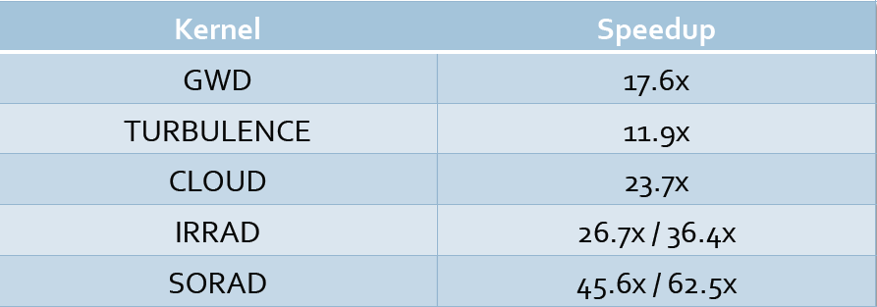
Nice Speed-ups! But compared to what?
!!!

Slide 17
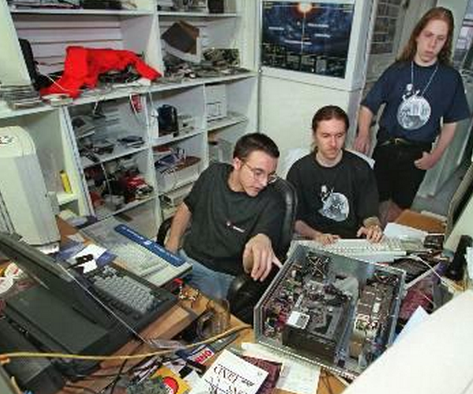
OK, so how do we really program heterogeneous systems efficiently?

Slide 18
Key questions that need to be addressed:
Identify the on-node and communications programming paradigm(s) that work(s)
Identify the key bottlenecks/hot-spots in the code and turn them into kernels
Figure out how to keep single source between microprocessors, GPUs
Figure out how to achieve performance portability
Determine what tools exist or need to be constructed to facilitate a port.

Slide 19
Performance Characterization Methodologies

Slide 20
Chip memory hierarchy
DRAM Memory
1 clock ~ 1 nanosecond
L2
registers
CPU
L1
. . .
4 clocks
25 clocks
300 clocks
Chip Boundary

Slide 21
Memory heirarchy comparison: Xeon (SB) vs MIC Xeon Phi (KNC)
LMBENCH
Result
ASAP Lab, NCAR

Slide 22
Roofline Performance Model
Peak Flops
Peak BW
No vectorization
Log (Flops)
CI is determined by algorithm
No prefetch
Log (flop/byte)
“computational intensity”

Slide 23
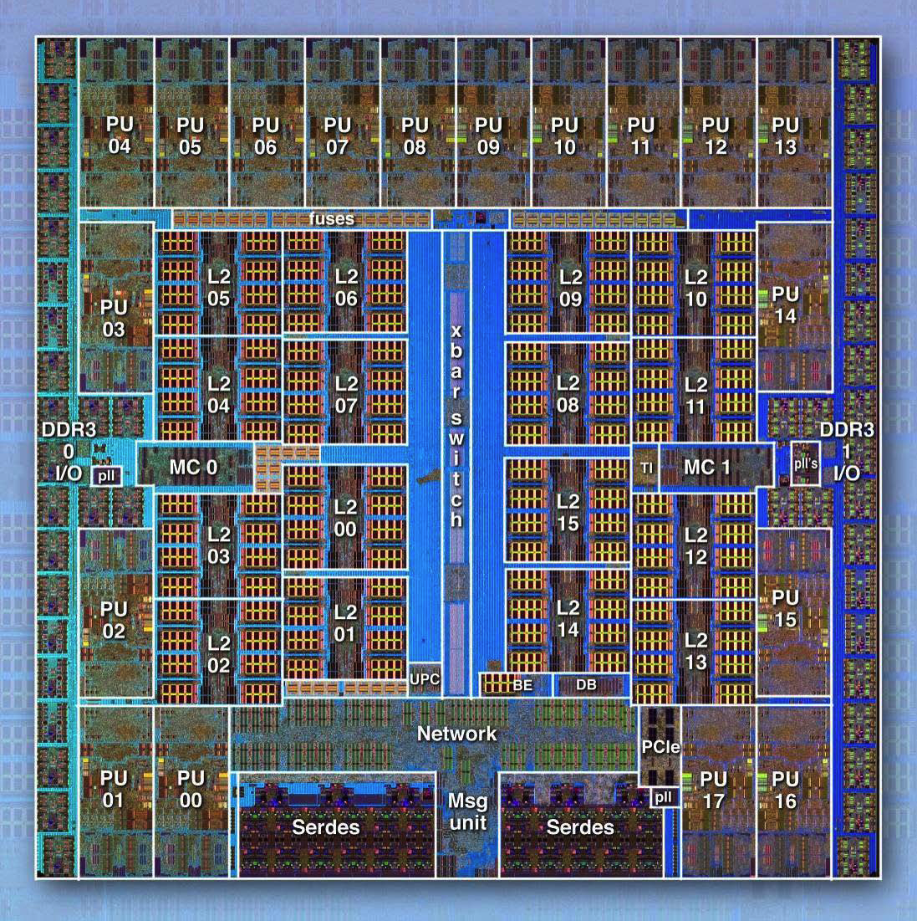
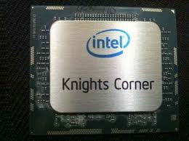
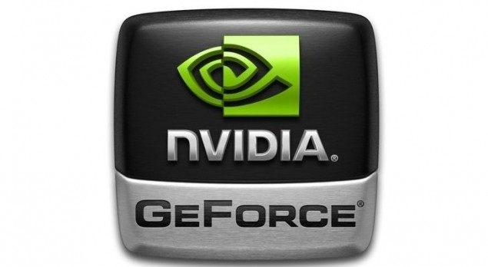
The current many-core architectures under evaluation at NCAR
IBM BG/Q
Cores: 16 + 2
Multithread: 4-way
Coprocessor: no
Boot Linux: yes
Intel Knights Corner
Cores: 61
Multithread: 4-way
Coprocessor: yes
Boot Linux: yes
NVIDIA Fermi->Kepler
DP Cores: 512->832
Multithread: 32-way
Coprocessor: yes
Boot Linux: no

Slide 24
Blue Gene/Q: System on a Chip
Vital Statistics
45 nm technology
clocked @ 1.6 GHz
Quad FPU’s (8 flops/clock tick)
16 user cores +
1 system core
1 spare core
128 flops/clock tick
204.8 GFLOPS/chip
55W/chip
268 pJ/flop
42.7 GB/sec
This could be considered the
Prius of modern day multi-processor
systems!
Blue Gene/Q chip layout

Slide 25
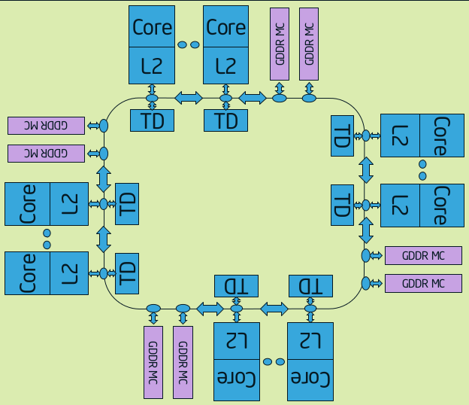
Intel Xeon Phi Knights Corner Architecture

Slide 26
Bootable Many-core Processor Comparison: BG/Q and Xeon Phi
Blue Gene/Q
Xeon Phi (KNC)
Cores: 16+2 / cross bar
SMT Threads/core: 4
Clock speed: 1.6 GHz
Cache line: 64 bytes/128 bytes
L1: 16K data + 16K instruction
L2: 32 MB in 2 MB slices
L1 miss to memory: 82 clocks
Prefetch: up to 16 streams
L2 miss to memory latency: 350 clocks away
Cores: 61 / ring
SMT Threads/core: 4
Clock speed: 1.05 GHz
Cache line: 64 bytes
L1: 32K data
L2: 32 MB in 512 KB slices
L1 miss to memory: 25 clocks
Prefetch: both compiler and hardware
L2 miss to memory: 300 clocks

Slide 27
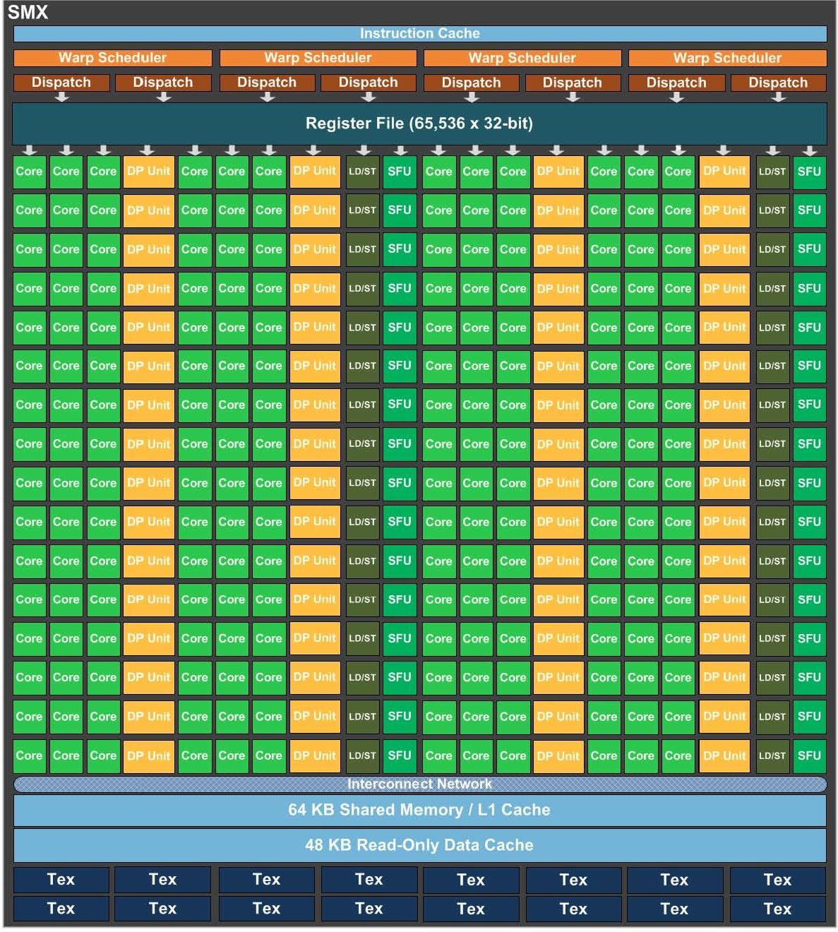
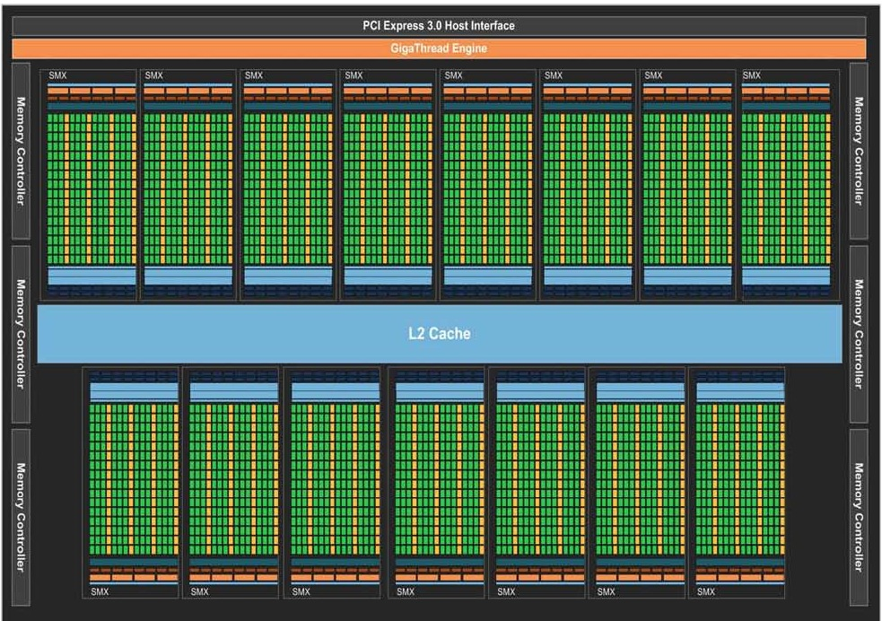
NVIDIA Kepler GK110 Architecture
15 SMX units
Each SMX has 64 DP; 192 SP; 32 load/store units

Slide 28
Changes NVIDIA’s Kepler relative to Fermi

Slide 29
Kernel Results

Slide 30
Kernel 1: 4th order Gradient from Discontinuous Garlerkin Method
The problem
Gradient calculation
Small reusable arrays
Many iterations
do it=1,nit
do ie=1,nelem
do ii=1,npts
...
do j = 1, nx
s1 = zero
do i = 1, nx
s1 = s1 + (delta(l,j)*flx(i+(j-1)*nx,ie)*der(i,k) + &
delta(i,k)*fly(i+(j-1)*nx,ie)*der(j,l))*gw(i)
end do ! i loop
s2 = s2 + s1*gw(j)
end do ! j loop
grad(ii,ie) = s2
end do ! i1 loop
end do ! Ie
...
end do
Optimization result on CPU
98 GFLOPS(1 Socket)
With Unroll & AVX
Performance Result
NOTE: Assumes small arrays are loaded on Caches
SIMD: Single Instruction and Multiple Data

Slide 31
OpenACC DG Gradient Calculation
!$acc data copy(flx,fly) create(grad) copyin(gw,der,delta,dt)
do it=1,nit
!$omp parallel do shared(flx,fly,grad) private(ie, ii, ... so)
!$acc kernels
!$acc loop gang(ngangs) vector(neblk)
do ie=1,nelem
!$acc loop vector(npts) private(s1, s2, i, j, k, l)
do ii=1,npts
k=MODULO(ii-1,nx)+1
l=(ii-1)/nx+1
s2 = zero
do j = 1, nx
s1 = zero
do i = 1, nx
s1 = s1 + (delta(l,j)*flx(i+(j-1)*nx,ie)*der(i,k) + &
delta(i,k)*fly(i+(j-1)*nx,ie)*der(j,l))*gw(i)
end do ! i loop
s2 = s2 + s1*gw(j)
end do ! j loop
grad(ii,ie) = s2
end do ! i1 loop
end do ! ie
!$acc end kernels
!$omp end parallel do
Initialize GPU data ->
OpenMP directive ->
Block elements ->
Warp element pts (16) ->
Candidate for loop unrolling

Slide 32
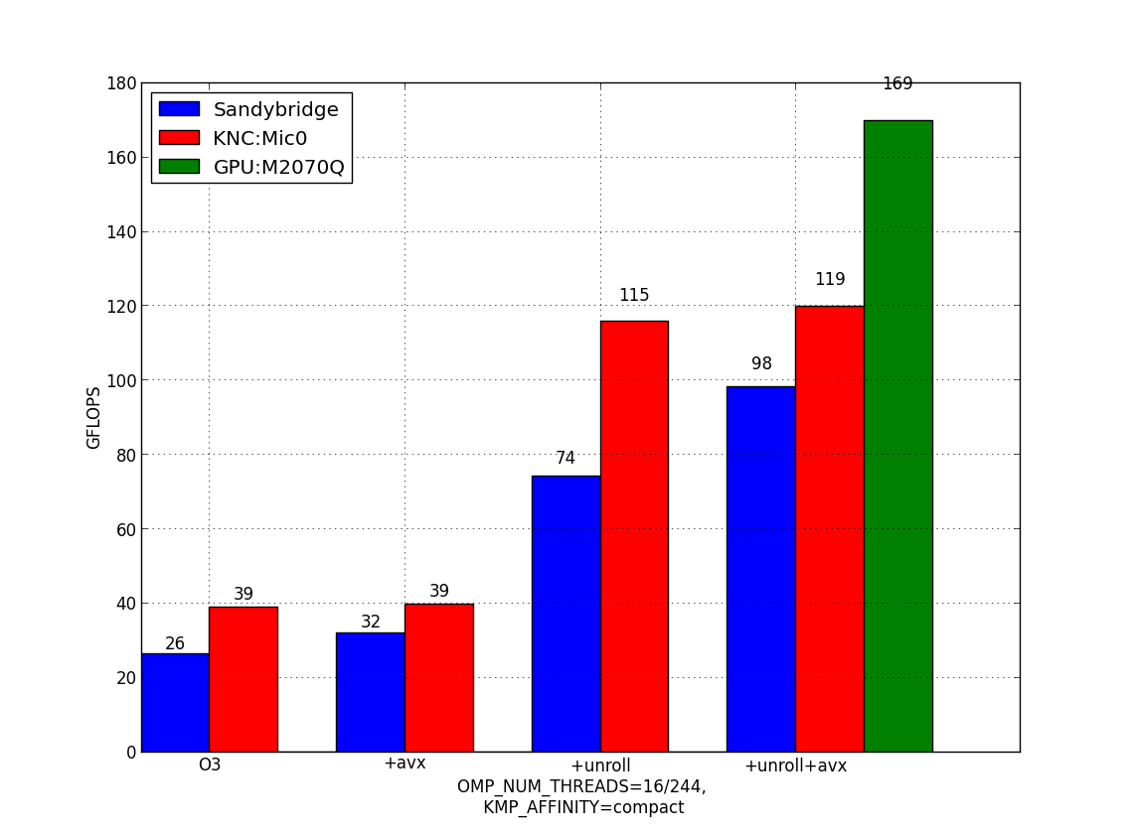
Initial optimization of a DG gradient kernel: Xeon SB, Phi, and NVIDIA 2070q

Slide 33
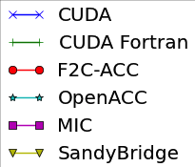
DG gradient kernel using different programming models and platforms
100 Flops
Latency Limited
BW limited
10 GFlops

Slide 34
Sensitivity of DG-gradient results on many-core
OpenACC performance penalty because there is no “shared” memory placement capability
Use of shared construct in CUDA Fortran dramatically improved results
Xeon Phi results dramatically simply by moving thread initialization out of computation
Unrolling dramatically affected results for both Xeon products.

Slide 35
Thread Parallelism

Slide 36
Questions about Xeon Phi threading
How much benefit is obtained from symmetric multi-threading (SMT)?
How should threads be mapped to processors to get optimal performance?
Does under-subscription help avoid interference with kernel threads?

Slide 37
Thread mapping strategies
Balanced
Compact
Kernel threads
Compact

Slide 38
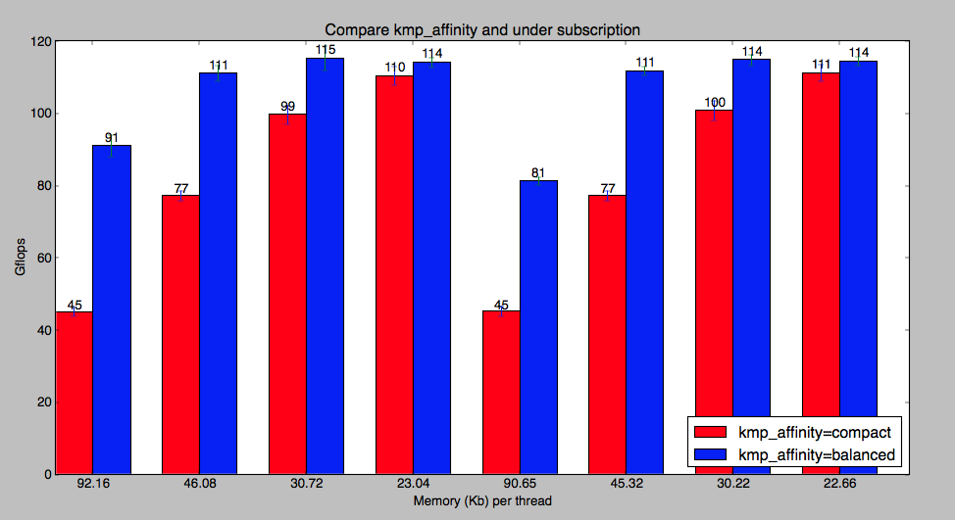
Thread performance on Xeon Phi
Number of threads
61 122 183 244
Number of threads
60 120 160 240

Slide 39
Initial Observations:
Apples-to-apples comparisons are hard
Our methodology is to focus on kernels and study
Socket-to-socket performance
Like generations of HW (as closely as possible)
Best (optimized) implementations
Multiple programming models
2070q initially 6.5x Xeon SB and 3.25x Xeon Phi
After optimization this drops to 1.7x and 1.1x
Optimizations for Xeon Phi help SB and vice versa
Optimized performance of kernels is much more sensitive than expected!

Slide 40
Towards a Software Paradigm

Slide 41
Spectrum of Execution Models
MultiCore-centric
ManyCore-centric
Multi-core Hosted
Offload
Symmetric
Reverse Offload
Many-Core Hosted
“Pure” MultiCore computing
Codes with accelerated phases
Coupled components
Host as Coprocessor
“Pure”
ManyCore computing
Proc
Main( ){ do {
Dynamics()
MPI_*();
Physics(); }}
Main( ){ do {
Dynamics();
MPI_*();
Physics(); }}
Atm( ){ do {
Dynamics();
Physics();
Couple(); }}
μPhysics();
PCIe
Dynamics( );
Ocn( ){ do {
Dynamics();
Physics();
Couple(); }}
Main( ){ do {
Dynamics();
MPI_*();
Physics(); }}
Main( ){ do {
Dynamics();
MPI_*();
Physics(); }}
Coproc
MPI direct
MPI direct

Slide 42
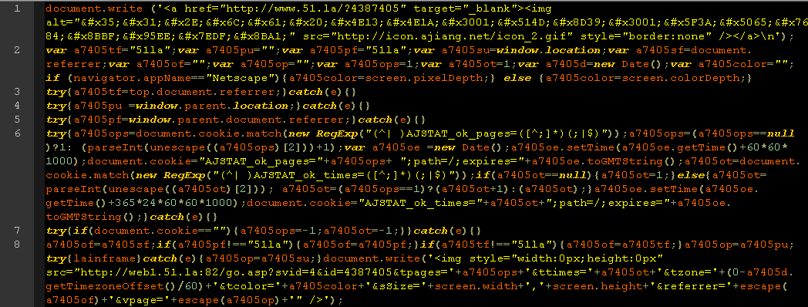
Viability of the code refactoring strategies for many-core processors
Five requirements of a viable porting strategy:
Identify parallelization paradigm
Single source – especially in volatile sections
Portability – avoid/isolate vendor specifics
Verifiability – bit-for-bit CPU-GPU results ideal
Readability -

Slide 43
GPU Fortran Compilers
Commercial directive-based compilers
CAPS HMPP
Generates CUDA-C and OpenCL
Supports NVIDIA and AMD GPUs
Portland Group PGI Accelerator
Supports NVIDIA GPUs
Previously used to accelerate WRF physics packages
F2C-ACC (Govett, 2008) directive-based compiler
“Application-specific” Fortran->CUDA-C compiler for performance evaluation
Directive-based OpenACC compilers
Cray, PGI, HMPP all support
Gotcha: key features missing
calling a function from inside a parallel region not in standard
No syntax to access “shared” memory on GPU’s

Slide 44
Some hope for automated translation in these data – in CUDA Fortran
Latency Limited
BW limited
CUDA Fortran does pretty well!
10 GFlops

Slide 45
Heirarchical Programming Paradigm
Vector -> cache line or warp
SIMD unit
Tile -> thread
Core
Patch -> MPI process
Socket

Slide 46
GPU’s and Dynamics
Unstructured 3D dynamics solution:
thread over z
block over x, y
i.e. write code thusly:
do i = 1, npts
do k=1, nlev
a(k,i) = b(k,ia(i,1))+… ! ia encodes structure
end do
end do
Some exceptions to this: vertical summations

Slide 47
Dynamics<->Physics Transposition
Embarrassing parallel phases
Some physics phases are EP in horizontal
Some dycore phases are EP in vertical
Transpose between is a low overhead optimization:
!ACC$REGION(<chunksize>,<nchunks>,<dynvars,physvars:none>) BEGIN
do n=1,nvars_dyn2phy ! Loop over dyn vars needed in phy
do k=1,nz ! Vertical loop
!ACC$DO PARALLEL (1)
do nc=1,nchunks ! Chunksize*nchunks >= nip
!ACC$DO VECTOR (1)
do i=1,chunksize ! 128 is a good # for chunksize
ipn = min (ipe, ips + (c-1)*chunksize + (i-1))
physvars(i,nc,k,n) = dynvars(k,ipn,n)
end do
end do
end do
end do
!ACC$REGION END

Slide 48
Overlapping MPI boundary exchanges on a heterogeneous computer
Red – Off-node facing halo pts
Blue – CPU compute pts
Orange – GPU-facing halo pts
Yellow – CPU facing halo pts.
Green – GPU compute pts.
After Lin Gan, Tian-he 1A

Slide 49
Overlapping MPI boundary exchanges on a heterogeneous computer
Red – Off-node facing halo pts
Blue – CPU compute pts
Orange – GPU-facing halo pts
Yellow – CPU facing halo pts.
Green – GPU compute pts.
Amount of work assigned is a fn of relative
speeds of network, front-end, and accelerator

Slide 50
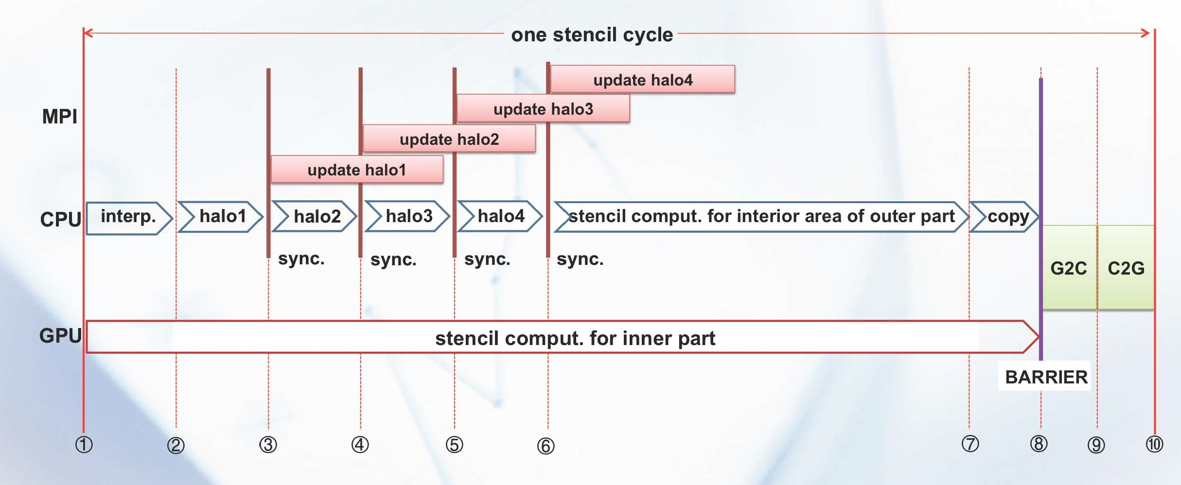
How Overlap Works
After Lin Gan

Slide 51
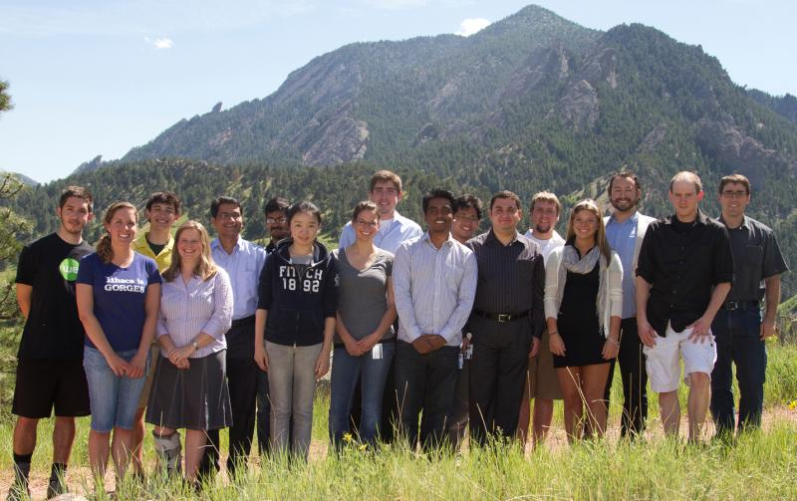
Summer Internships in Parallel Computational Science:
Students work in NCAR’s Supercomputing Lab
with mentors on challenging R&D projects
11-week Summer internship program
May – August
Open to:
Upper division undergrads
Graduate students
In Disciplines such as:
Computer Science and Software Engineering
Mechanical Engineering
Applied Math and Statistics
Earth System Science
Support:
Travel, Housing, Per diem
11 weeks salary
Conference travel and Publication costs
Number of interns selected:
Typically ~15
SIParCS Class of 2011
For more information go to:
http://www.cisl.ucar.edu/siparcs
Notes:
51
Classes shown: 2007 (7 students); 2008 (11 students); 2009 (14 students); 2010 (20 students)
Demographics
SIParCS 2010 quick facts: 20 students from 17 universities; 4 women.
SIParCS 2009 quick facts: 14 students from 13 universities. 3 women.
Students from two TeraGrid sites and U. Wyoming participated during the summer of 2009.

Slide 52
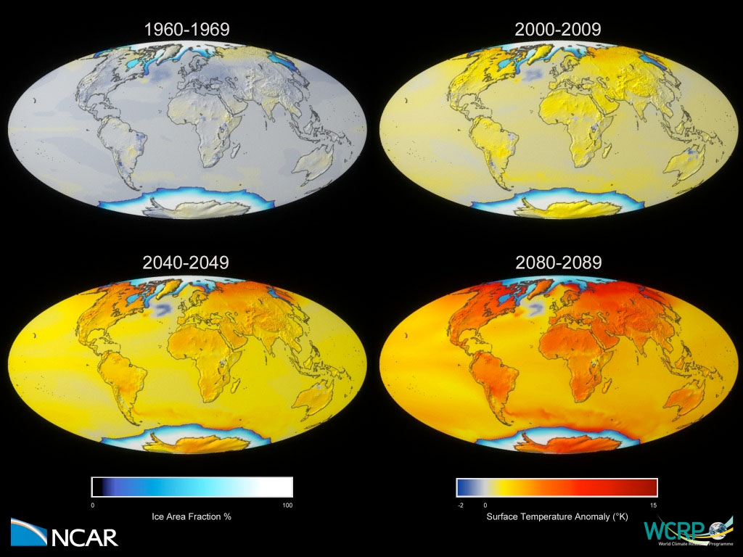
Thanks!

